Slide 1
Anomaly Detection in real-world temperature sensor data
Presenter: SYED MOEEN ALI NAQVI
INFORMATION SECURITY LAB, KOOKMIN UNIVERSITY
https://github.com/moeennaqvi

Slide 2
Topics
Introduction
Motivation
Types of anomalies
Data description
Feature Engineering
Techniques for anomaly detection
Markov Chains
Isolation forest
One class state vector machine
Recurrent neural network (RNN)

Slide 3

Introduction
Anomaly: a point in time where the behavior of the system is unusual and signiﬁcantly different from previous, normal behavior.
It can either be positive or negative depending upon the situation.
Anomalies can be spatial, temporal or contextual.

Slide 4
Motivation
Lots of sensors pervading our everyday lives nowadays
Sensors’ data is used for many crucial decisions
Sensor information like temperature information is used inside many industries like manufacturing factories, nuclear reactors, server rooms etc.
It’s significant to detect anomalies so relevant actions can be taken in time.

Slide 5
Types of anomalies
Point Anomalies. Data point anomalous with respect to the rest of the data
Contextual/Temporal Anomalies: If a data instance is anomalous in a specific context
Collective Anomalies. If a collection of related data instances is anomalous w.r.t. entire data set not individual values. There are two variations:
Events in unexpected order ( ordered. e.g. breaking rhythm in ECG)
Unexpected value combinations ( unordered. e.g. buying large number of expensive items)

Slide 6
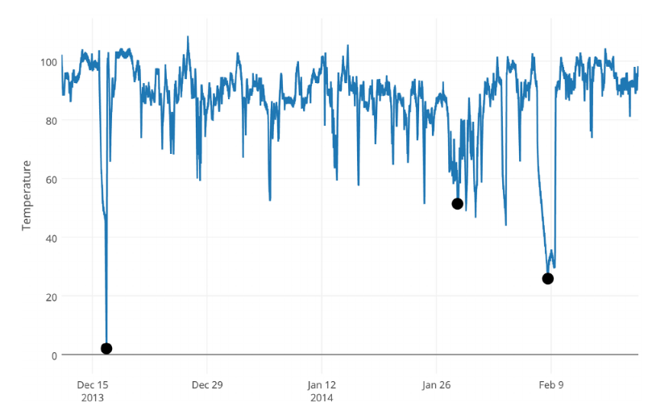

Slide 7
Data description
There are two columns in data:
Timestamp and temperature
It’s a real-world temperature sensor data from an internal component of a large industrial machine.
Data is taken over a period of one year (i.e. from 7-2013 to 6-2014)
Data is taken from NAB (Numenta Anomaly Benchmark)
https://github.com/numenta/NAB

Slide 8
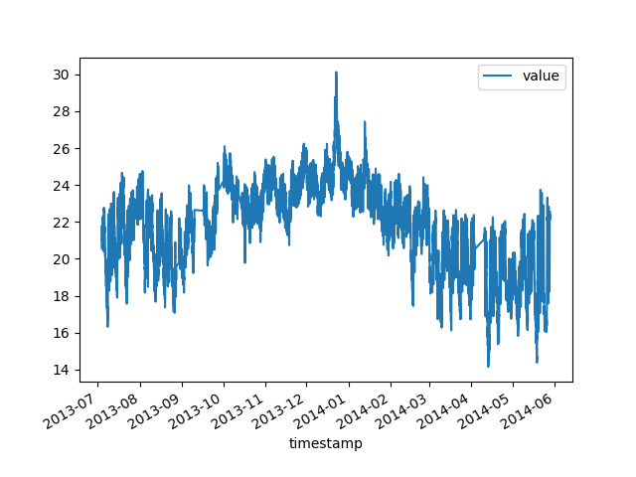
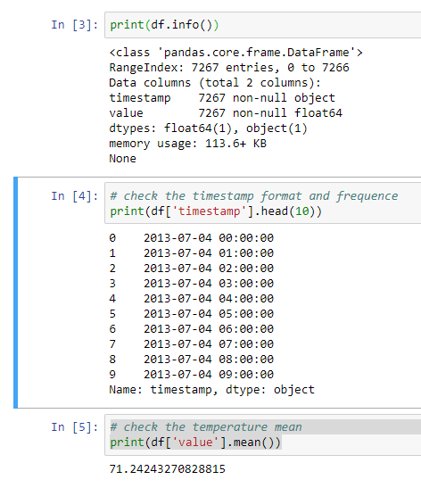
Data description

Slide 9
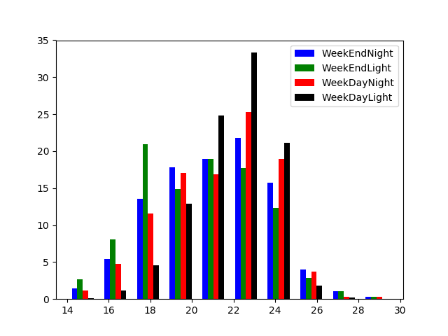
Feature Engineering
We extracted some useful features from data. It contains:
Hours of the day
Daylight (day or night)
Day of the week
WeekDay

Slide 10
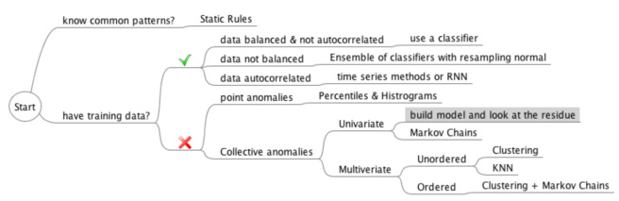
Techniques for anomaly detection
Our focus is on finding collective and sequential/temporal anomalies.
Techniques used are:
Markov chains
Isolation forest
One class SVM
RNN

Slide 11
Markov Chains
A Markov chain is "a stochastic model describing a sequence of possible events in which the probability of each event depends only on the state attained in the previous event
We used it for detecting ordered temporal anomalies.
We needed to discretize the data points in define states for Markov chain.
We define 5 levels of value (very low, low, average, high, very high)/(VL, L, A, H, VH).
Markov chain will calculate the probability of sequence like (VL, L, L, A, A, L, A). If the probability is very weak we consider the sequence as an anomaly.

Slide 12
Isolation forest
One of the newest techniques to detect anomalies
It isolates observations by randomly selecting a feature and then randomly selecting a split value between the maximum and minimum values of the selected feature
We used it for detecting unordered collective anomalies
It works well with high dimensional data

Slide 13
One class state vector machines
It is used for novelty detection.
There shouldn’t be any anomalies in the training set
Works well with multidimensional data.
We used it for unordered collective anomalies.

Slide 14
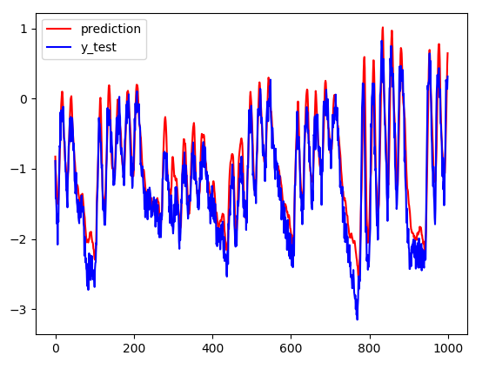
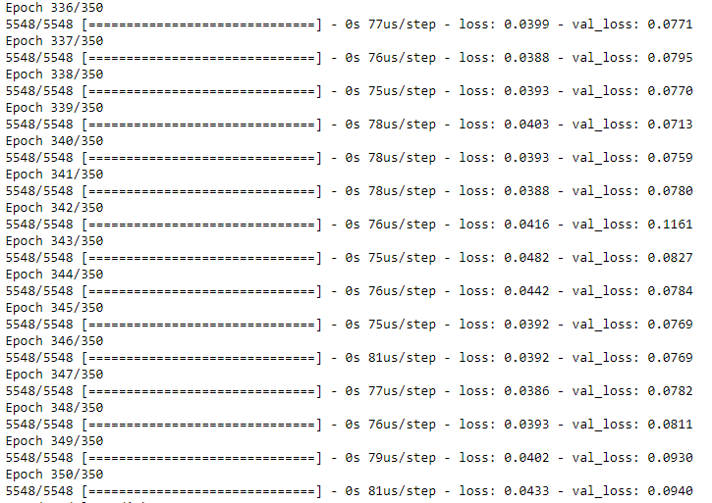
Recurrent Neural Network (RNN)
RNN learn to recognize sequence in the data and then make prediction based on the previous sequence.
Here we make learn from 50 previous values, and we predict just the 1 next value.
We used LSTM using keras API to implement RNN.

Slide 15
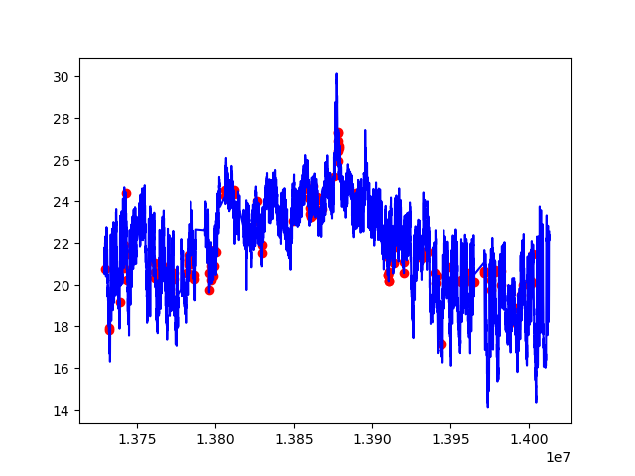
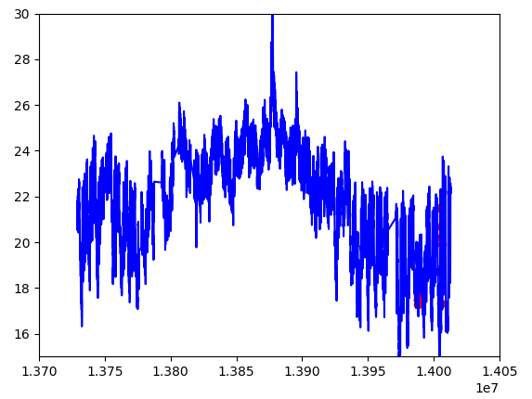
Results
Visualization of ordered sequential anomalies detection throughout time
Markov chain
RNN

Slide 16
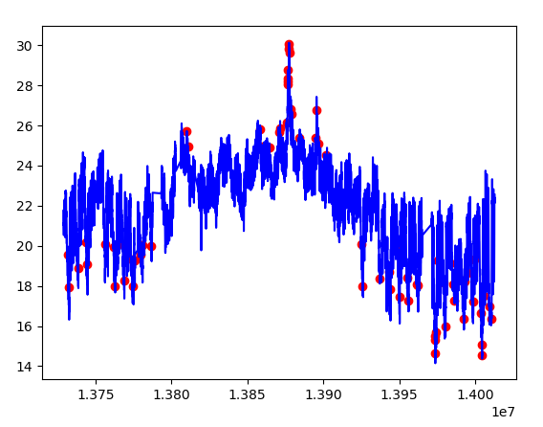
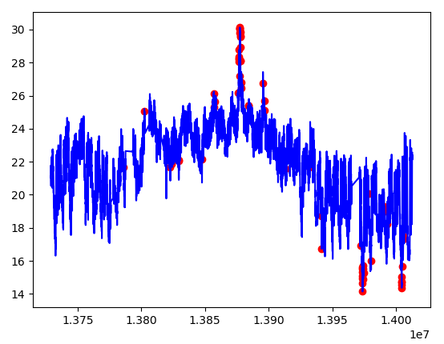
Results
Isolation forest
Visualization of unordered collective anomalies detection throughout time
One class SVM

Slide 17
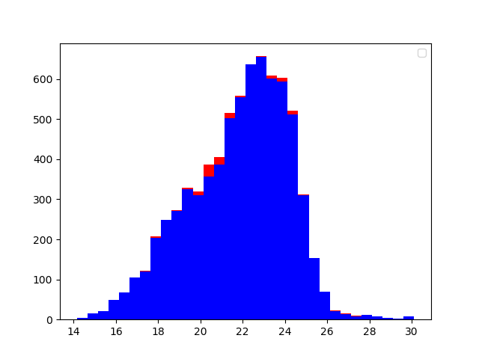
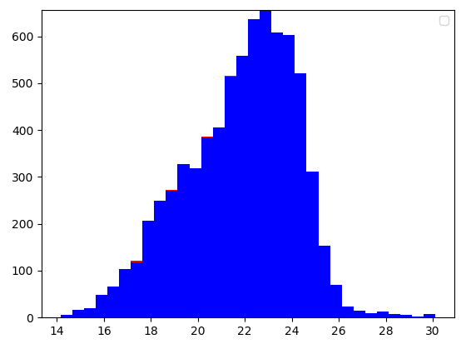
Results
Markov chain
Visualization of ordered sequential anomalies detection with temperature repartition
Markov chain
RNN
RNN

Slide 18
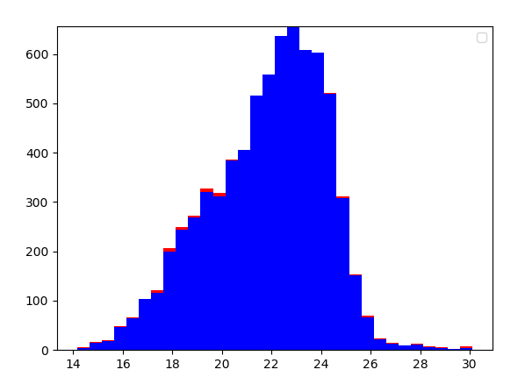
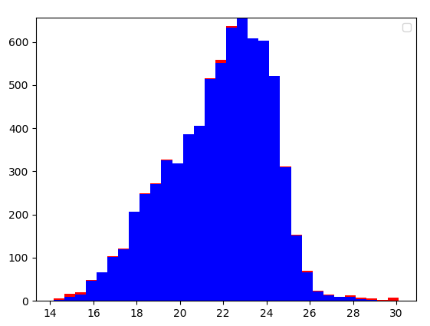
Results
Visualization of unordered collective anomalies detection with temperature repartition
Isolation forest
One class SVM

Slide 19
Any Questions? Thank you.

